Slide 1
Database Systems

Slide 2
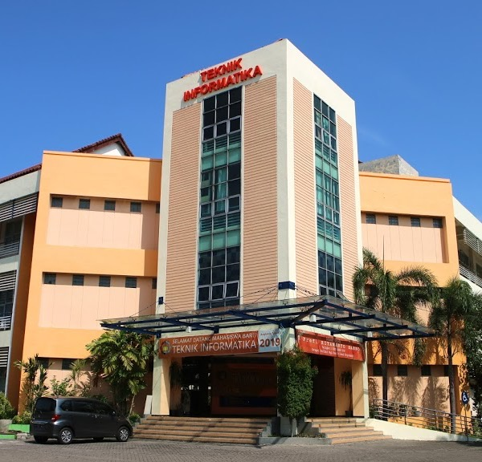
Database Concepts
Introduction to Entity, Attributes and Relationship
SBD Lecturer team

Slide 3
Outline
Entity
Attributes
Relationship
Practice

Slide 4
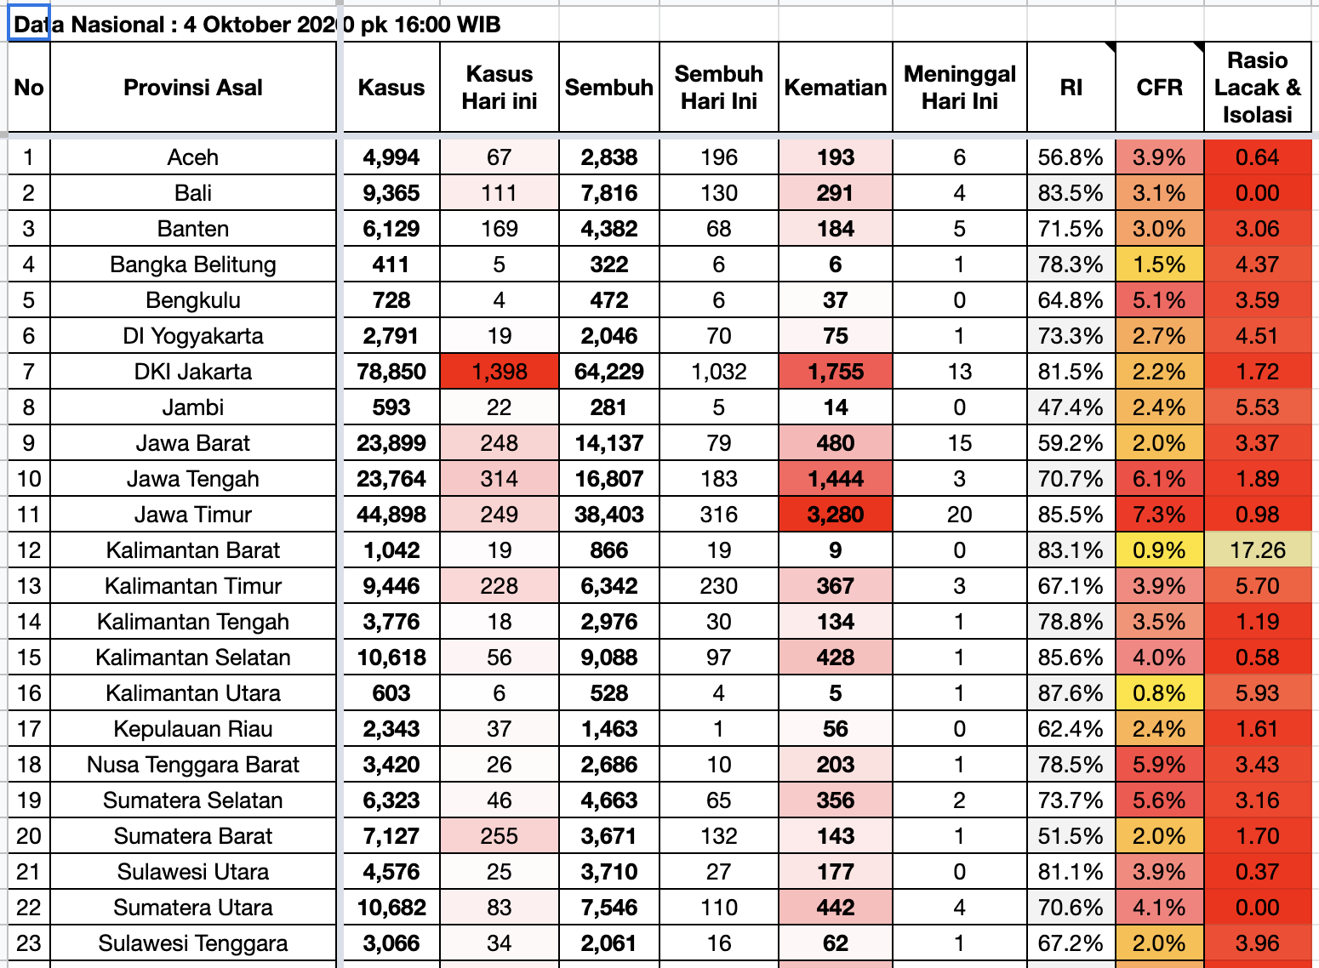
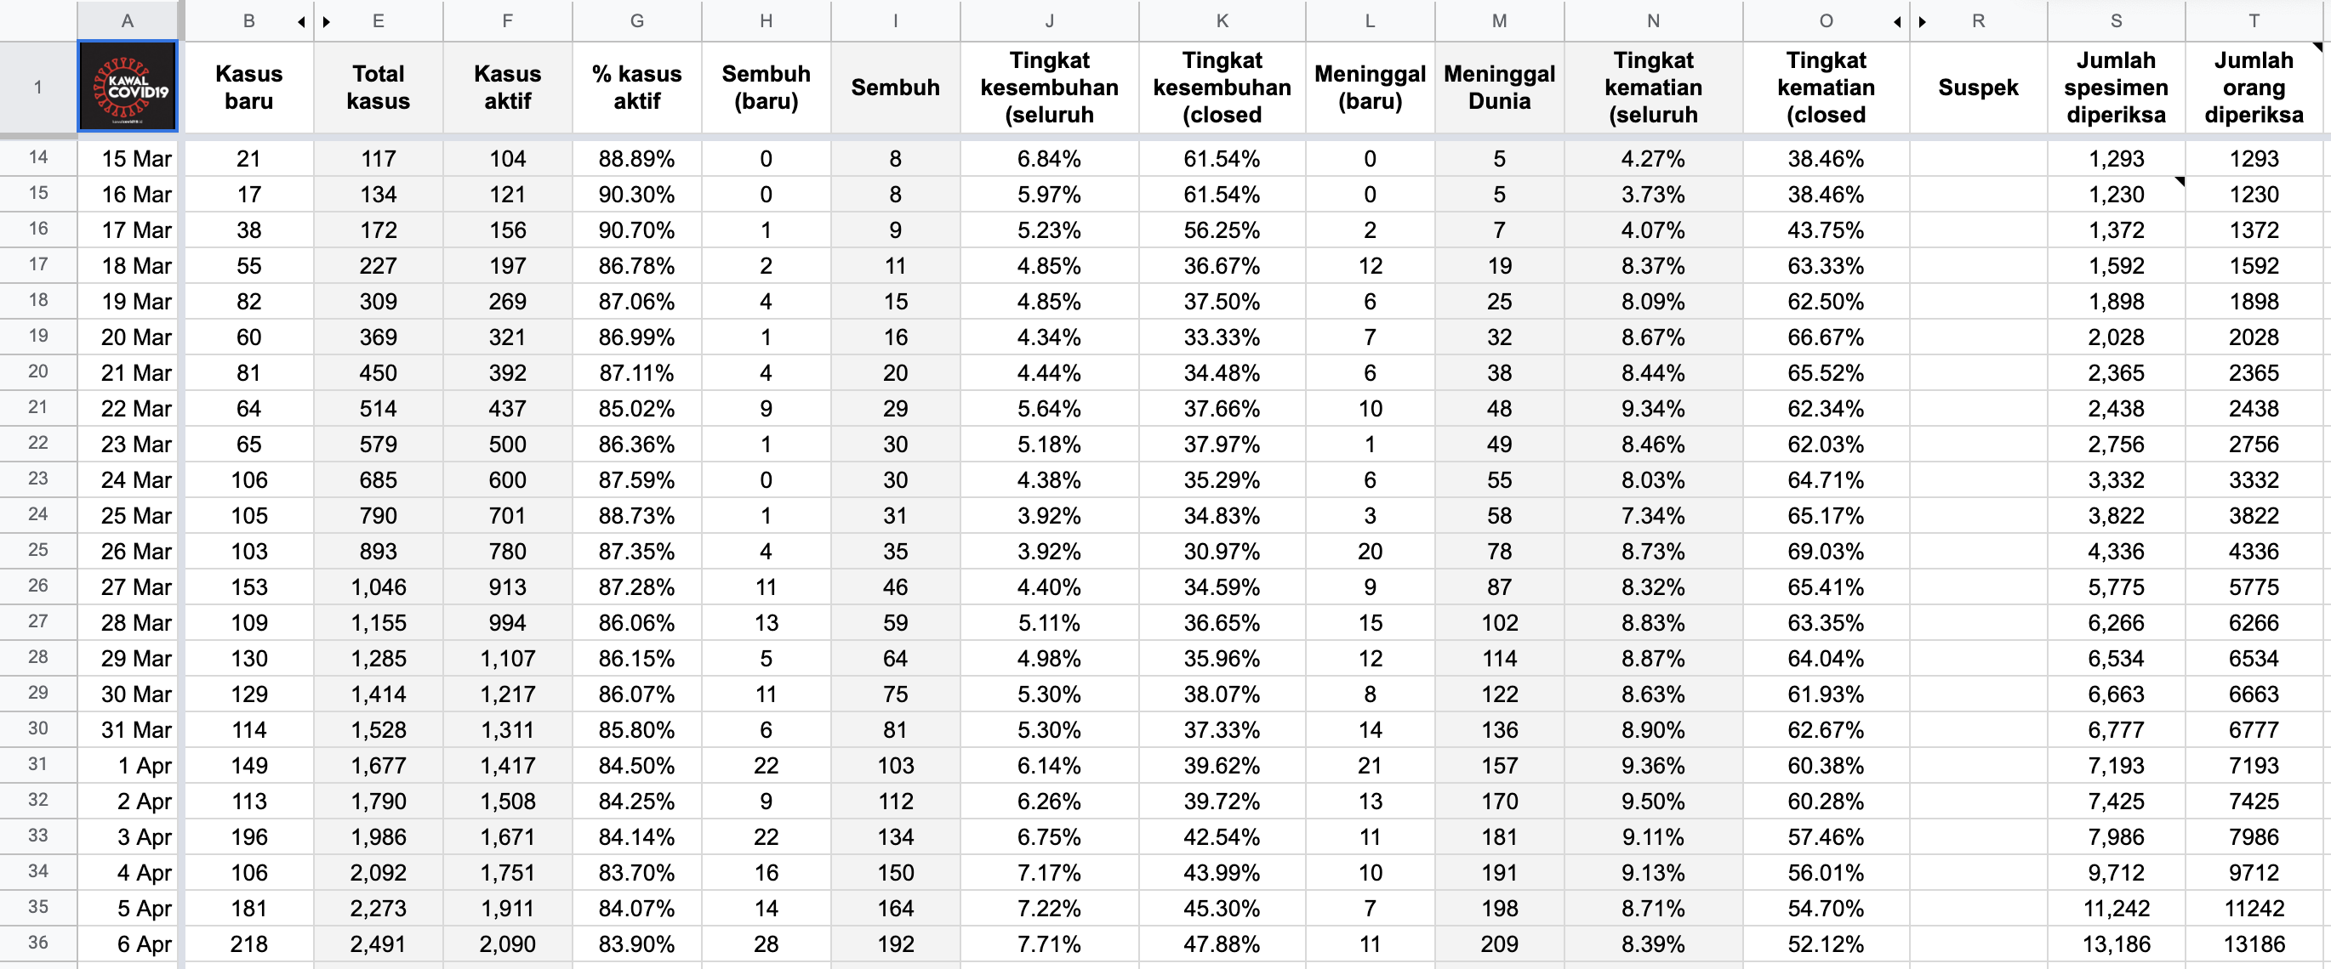
Collection of data to be stored in a Database

Slide 5
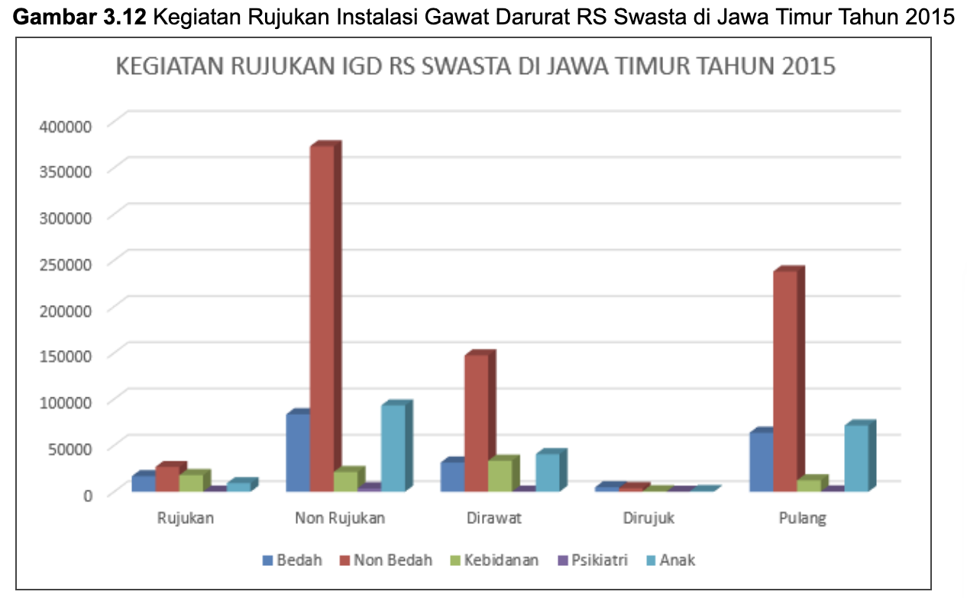
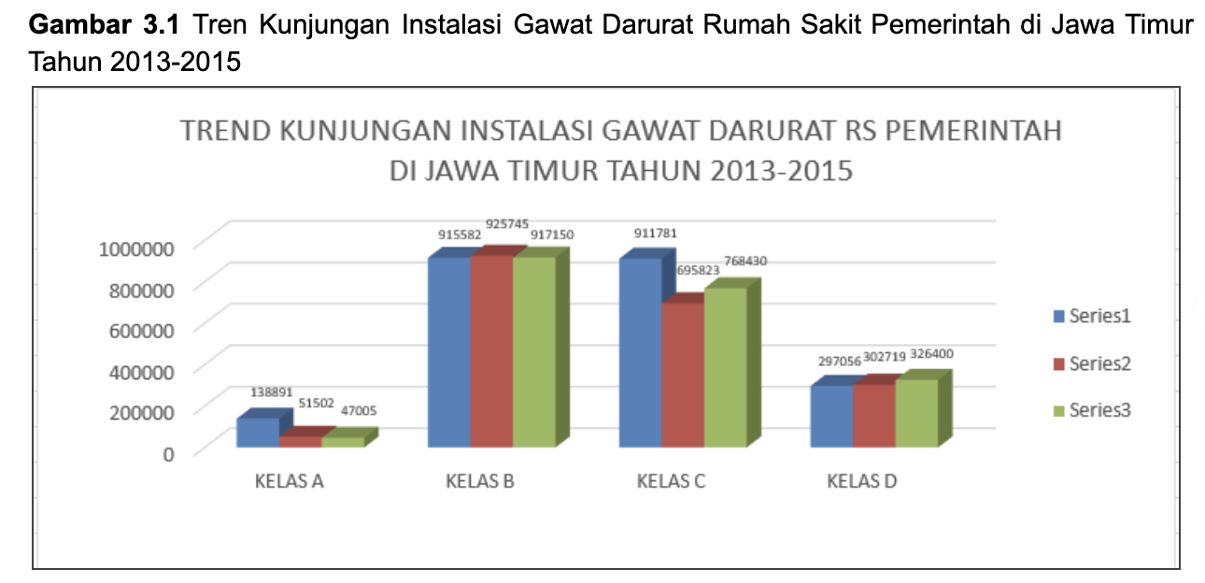
Desired Data Visualization

Slide 6
Question:
How to map all those data into database?

Slide 7

Database Overview

Slide 8
Entity
Entities are objects or events that exist in the real world that distinguish these objects from other objects.
An entity in the database is described using a set of attributes.
Example:
Student
Employee

Slide 9
Entity can be:
[1] Physical
Human
Car
[2] Abstract/Concept
Department
Job
House
Course
[3] Event
Purchase
Sales Transaction
Loan Transaction

Slide 10
Attributes
Attributes are data items that are characteristic of an entity.
Example:
Employees have the following attributes:
Employee
Eno
Name
Address
Phone
…?

Slide 11
How to Find Entities and Attributes?
Make an illustration/illustration of the story about the system that the entity will look for
Mark each object represented by the noun in the illustration
For each object, make sure that it has characteristics which are later referred to as attributes
Determine which object is an entity (If it has characteristics make it an entity)

Slide 12
Key Points
Each entity has a unique key
Each attribute has a domain
Each attribute defines the characteristics of each entity

Slide 13

Case Study
At a university there is an FRS process. In this process, students will meet their supervisor/lecturer to ask for approval of the courses taken in each semester.
Design the entities that make up the business process.

Slide 14
Steps (1)
Make an illustration of the story about the system that the entity will look for
ITS is one of the best universities in eastern Indonesia.
ITS has 10 faculties consist of more than 60 departments.
A department has lecturers and students.
Lecturers have at least one guardian student who is a student in the department.
The student will contact the lecturer to help approve the classes taken each semester.
Each semester there are many classes offered in a department.
Each class offered has a schedule.
Students can take at least one class offered in the semester.
Each class offered has at least one teaching lecturer.
Usually a course has at least one class that is opened each semester.

Slide 15
Steps (2)
Mark each object represented by the noun in the illustration
ITS is one of the best universities in eastern Indonesia.
ITS has 10 faculties consist of more than 60 departments.
A department has lecturers and students.
Lecturers have at least one guardian student who is a student in the department.
The student will contact the lecturer to help approve the classes taken each semester.
Each semester there are many classes offered in a department.
Each class offered has a schedule
Students can take at least one class offered in the semester.
Each class offered has at least one teaching lecturer.
Usually a course has at least one class that is opened each semester.

Slide 16
Steps (3)
Look for characteristics called attributes of each entity
Lecturer
NIP
Name
Student
NRP
Name
Department
Id
Address
Address
Phone
Email
Rank
Department
Address
Phone
Email
Batch
Graduate/Year Out
Name
Phone
Fax
Email
Faculty
Faculty
Id
Name
Address
Phone
Fax
Email
Id
Accreditation
Uiversity
Name
Address
Phone
Fax
Email

Slide 17
Steps (4)
Guardian student
NRP
Name
Schedule
ID_Schedule
Class
Id
Address
Phone
Email
Supervisor/Lecturer
Semester
Id
Name_Semester
Period
ID_Course
Start_time
End_time
Year
Id_Course

Slide 18
Steps (5)
From the previous table list, there are several tables that only have one example data:
University data contains only one row of data
Semester data only has two rows, namely even semesters and odd semesters.
Semester data is replaced with a period table that can include year and semester type attributes.
So, the table should be deleted and the information combined in another table.

Slide 19
Practice
We currently manage three guest houses, namely Flamboyan, Bougenville and Jasmine. However, the management of the three guest houses is still carried out separately in each of the guesthouses. We hope that in the future this management process will be incorporated into an integrated system.
The current process is that guests must come to the guesthouse they want to go to to be able to place an order. Next, the guest will check-in on the D day and choose the appropriate room type and leave an ID card so that the receptionist can record the identity, room and check-in date. For our Flamboyan and Bougenville guesthouse, we have several types of rooms. Especially for Jasmine guesthouse, this guesthouse is rented out for one house. At check-out, the receptionist will calculate how long the stay is, and whether there are additional facilities used, such as extra beds. After the payment is completed, the identity card will be returned. To improve the service of the guesthouse, every guest who checks out is asked to fill out a customer satisfaction questionnaire such as satisfaction with receptionist service, room cleanliness, hospitality of the guest house staff, room comfort, etc.

Slide 20
Relationship
Relationship is a relation between two or more entities.
Example:
Employees work as staff in the HR unit of a company
Based on these data, it can be seen the following things :
There are entities: Employees, positions (staff), work units, and companies.
The relationship of each entity is as follows :
A company has at least one work unit.
A work unit has at least one serving employee.

Slide 21
Types of Relationships between Entities
Strong Entity
An entity that stands alone without being dependent on other entities.
Can be uniquely identified using its own attributes, one / several of its attributes being the PRIMARY KEY.
Example: Employee
Weak Entity
An entity that cannot be uniquely identified through its attributes alone, so it depends on other entities
Using attributes from other entities (foreign key)

Slide 22
Example
In the following case examples:
Dependents of employees. If the employee is deleted, the dependent data will also be deleted
Employee
Dependent
EID
Name
Rank
etc
D_name
D_relationship
D_bdate
T_JenisKel

Slide 23
Cardinality
From the previous statement:
A company has at least one work unit.
A work unit has at least one serving employee.
So, the relations of an entity can be grouped into:
[1] One to one
[2] One to many
[3] Many to one
[4] Many to Many

Slide 24
One to one
Example:
An employee can only have 1 position in the company.

Slide 25
One to many
Example:
One company has at least one or more (many units) work.

Slide 26
Many to one
Example:
Many employees are placed in a work unit.

Slide 27
Many to many
Example:
There is more than one extra-curricular that more than one student can take.

Slide 28
Steps in Determining Relationships
From the description of the system story, mark each relationship represented by the verb in the illustration along with the associated entity
Identify the cardinality ratio of each relationship
Identify the participation limits of each existing relationship and the possible attributes that arise from each relationship
Draw the relationship in the form of a diagram notation and combine it with the previously created Entity and attribute notation

Slide 29
1. Mark relationships
ITS is one of the best universities in eastern Indonesia.
ITS has 10 faculties consist of more than 60 departments.
A department has lecturers and students.
Lecturers have at least one guardian student who is a student in the department.
The student will contact the lecturer to help approve the classes taken each semester.
Each semester there are many classes offered in a department.
Each class offered has a schedule
Students can take at least one class offered in the semester.
Each class offered has at least one teaching lecturer.
Usually a course has at least one class that is opened each semester.

Slide 30
Entity 1 | Relationship | Entity 2
University (ITS) | Has | Faculty
Faculty | Consist of | Department
Department | Has | Lecturer
Department | Has | Student
Lecturer | Has | Guardian Student
Guardian Student | Is | Student
Guardian Student | Contact | Lecturer
Lecturer | Approve | Class
Semester | Has | Class
Class | Has | Schedule
Student | Take | Class
Class | Has | Teaching Lecturer
Course | Has | Class
For the same relationship, just choose one
Relationship with the same business process, can be merged

Slide 31
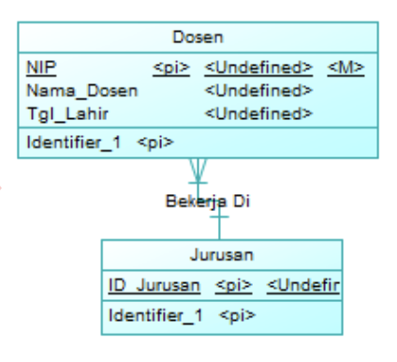
Entity 1 | Participation of Entity 1 | Relationship | Participation of Entity 2 | Entity 2
University (ITS) | 1, N | Has | 1, 1 | Faculty
Faculty | 1, N | Consist of | 1, 1 | Department
Department | 1, N | Has | 1, 1 | Lecturer
Department | 1, N | Has | 1, 1 | Student
Lecturer | 1, N | Has | 1, 1 | Guardian Student
Guardian Student | 1, 1 | Is | 1, 1 | Student
Semester | 1, N | Has | 1, 1 | Class
Class | 1, 1 | Has | 1, 1 | Schedule
Student | 1, N | Take | 1, N | Class
Class | 1, N | Has | 1, N | Teaching Lecturer
Course | 1, N | Has | 1, 1 | Class

Slide 32
Data Type
Number/ Numeric
Text / String
Date
Blob
Etc.

Slide 33
Numeric Data Types
Data types | Note | Range | Size
TYNYINT | Positive and negative integer | -128 up to 127 | 1 byte (8 bit)
SMALLINT | Positive and negative integer | -32.768 up to 32.767 | 2 byte (16 bit)
MEDIUMINT | Positive and negative integer | 8.388.608 up to 8.388.607 | 3 byte (24 bit)
INT | Positive and negative integer | 2.147.483.648 up to 2.147.483.647 | 4 byte (32 bit)
BIGINT | Positive and negative integer | ± 9.22 x 10¹⁸ | 8 byte (64 bit)
FLOAT | Single precision floating number | 1.2E-38 up to 3.4E+38 | 4 byte ( 32 bit)
DOUBLE | Double precision floating number | 2.3E-308 up to 1.7E+308 | 8 byte (64 bit)
DECIMAL | Positive and negative fraction number | -1.79…E+308 up to -2.22…E-308 | 8 byte (64 bit)

Slide 34
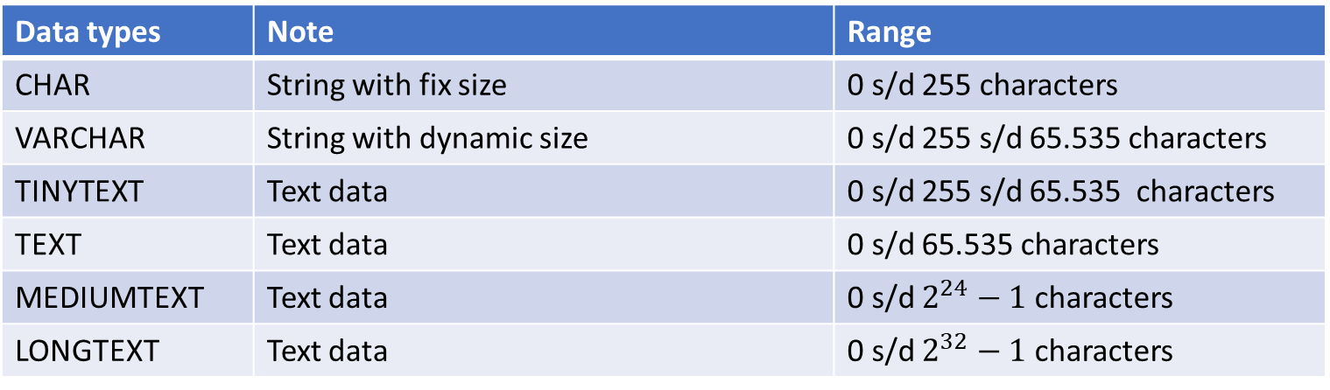
Text data types
Data types | Note | Range
CHAR | String with fix size | 0 s/d 255 characters
VARCHAR | String with dynamic size | 0 s/d 255 s/d 65.535 characters
TINYTEXT | Text data | 0 s/d 255 s/d 65.535 characters
TEXT | Text data | 0 s/d 65.535 characters
MEDIUMTEXT | Text data | 0 s/d $2^{24}−1$ characters
LONGTEXT | Text data | 0 s/d $2^{32}−1$ characters

Slide 35
Date data types
Data types | Note | Range | Size
DATE | Date data type | 1000-01-01 s/d 9999-12-31 (YYYY-MM-DD) | 3 byte
TIME | Time data type | -838:59:59 s/d +838:59:59 (HH:MM:SS) | 3 byte
DATETIME | Date and time | ‘1000-01-01 00:00:00’ s/d ‘9999-12-31 23:59:59’ | 8 byte
YEAR | Year of a date | 1900 s/d 2155 | 1 byte

Slide 36
Blob data types
Data types | Note | Range
BIT | Binary data | 64 digit binary
TINYBLOB | Binary data | 255 byte
BLOB | Binary data | 216 – 1 byte
MEDIUMBLOB | Binary data | 224 – 1 byte
LONGBLOB | Binary data | 232 – 1 byte

Slide 37
Practice
The outbreak of the Covid-19 virus has caused many universities to adopt a policy of studying from home. To support the teaching and learning process, many universities innovate by creating an online attendance system.
In this system, all academics (lecturers, employees, and students) will take attendance online.
Design the entities, attributes, and relationships that make up the business process.

Slide 38
- THANK YOU-

Slide 39
Tamu: kartu identitas, kamar yang dipilih, tanggal check in, tgl chek out, lama menginap, fasilitas tambahan
Wisma tamu: pengelolaan, resepsionis, layanan, Nama wisma, Alamat, rate, jml kamar
Layanan: jenis layanan, harga layanan
Karyawan: NIP, Nama, jenisKerja
Jenis kamar: no kamar, nama kamar, harga
Wisma: tipe wisma, no kamar, nama kamar, harga

